Slide 1
Todays plan
Today you will act as an environmental consultancy team.
Visit survey a site.
Map its key environmental features.
Assess a hypothetical development proposal.
Identify potential environmental impacts.
Recommend ways to avoid or reduce those impacts.
Present your findings as a team.

Slide 2
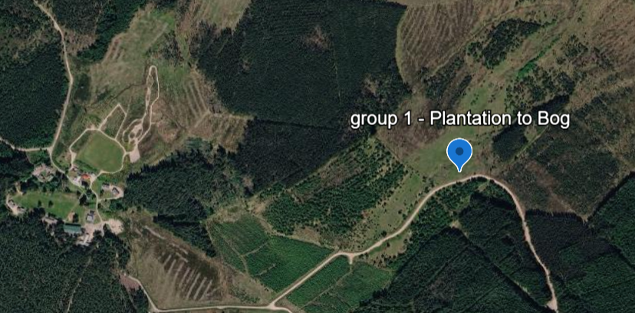
Group 1: 57°10'56.17"N 3°42'42.37"W
Development: Forest to bog restoration
Supervisors: Jacob & Helene

Slide 3
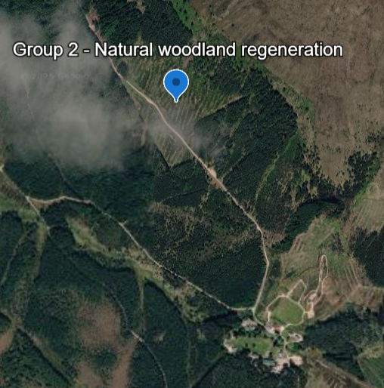
Group 2: 57°11'24.40"N 3°44'04.25"W
Development : Multiple Species natural regeneration
Supervisors: Ashish & Felipe

Slide 4
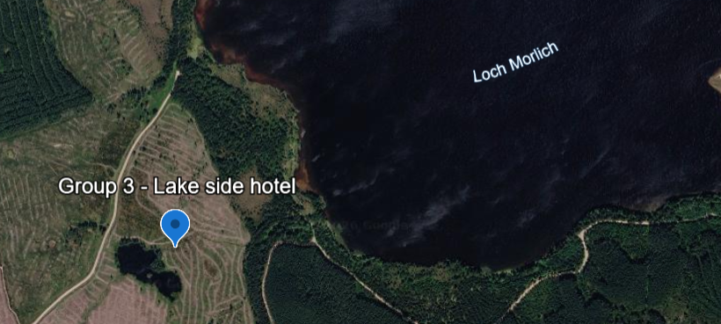
Group 3: 57°11'24.40"N 3°44'04.25"W
Development: Large Hotel
Supervisors: James & Beatrice

Slide 5
This mornings task 9:30 to 12:00
Make a map of the soils, biodiversity and freshwaters of your site
The aim is to create a shared picture of the site that you can use later when thinking about the potential impacts of development.
Make sure you are specific about detail e.g. types of soil, direction of channel flow, different habitat and vegetation types

Slide 6
Afternoon Task
Prepare a 15 minute presentation (15 minutes presentation + 2 mins questions) ACTIVITY HALL – 16:30 start
Split group into 3 sub groups (Soils, freshwaters, biodiversity)
Presentations should focus on the impacts of hypothetical development on each of the three sub groups
Each presentation will have to rank which environment would be most affected by their proposed development (1 = most sensitive)

Slide 7
Slide contents (not limited to)
Each sub group should present 5 minutes on:
You will need an overall intro slide introducing the development and area of interest
A map showing the sensitive features for the whole development area
Describe the impacts the activity (development) would have on the sub group theme
Mention what methods and where they would measure to generate a baseline for these
Pictures are always useful to show examples of sensitive areas/species etc.

